Slide 1


TECH EXPO – 2K25
GENERATION OF GROUP CREATIVITY
VYATIHAR
PRESENTED BY- Jagriti, Mansi, Khushi, Sneha, Kashish

Slide 2





“WHERE IDEAS MEET”

Slide 3



WHAT IS VYATIHAR ?
SaaS Technology
Knowledge & Project Hub
Free Platform
Willingness to share and learn
Equality, Community, Collaboration

Slide 4

IS THERE ANYONE WHO CAN TEACH ME FINANCE FOR FREE?
IS THERE ANYONE WHO CAN TEACH ME MARKETING FOR FREE

Slide 5


EXISTING PROBLEMS OF OTHER APPS
Lack of Personalization
Low Opportunities & Time Boundation
Limited Interaction
Technical Issue
Authentication Issues
Data Privacy & Security Concerns

Slide 6
Our Solution
One-on-one Interaction
24/7 Availability and AI Matchmaking
Interactive Sessions
No Privacy Concerns and No Leak of Information
Personalized Content

Slide 7

OUR PROMISES
Skill barter System
1.
2.
3.
4.
AI Matchmaking
Free Learning Platform
Multi- Language Support
5.
6.
Community & Networking
Verification & Doubt
Solving

Slide 8

INSIGHTS OF VYATIHAR
COLLABORATIVE PROJECT INCUBATION MODULE
KNOWLEDGE AND PROJECT HUB
IDEA PITCHING & TEAM FORMATION
MENTORSHIP ACCESS
VIRTUAL INCUBATION SUPPORT

Slide 9



autobiography and biography
SKILL EXCHANGE MODULE
SKILL PROFILES
literary analysis
PEER-TO-PEER LEARNING
explanatory essays
types of informative texts
The informative or explanatory genre covers a range of text types such as such as:
INTEGRATED COMMUNICATION
summaries
RATING & REVIEW SYSTEM
scientific reports
GAMIFICATION AND REWARDS
historical accounts
scholarly articles

Slide 10



USER ONBOARDING PROCESS
Download the App
Sign up for Free
Fill your Details and generate password
Select Language
Select Course

Slide 11


Find Your AI Match
Choose Subject
Start Learning
.
Doubt Solving Sessions
Get Rewarded & Provide Feedback

Slide 12
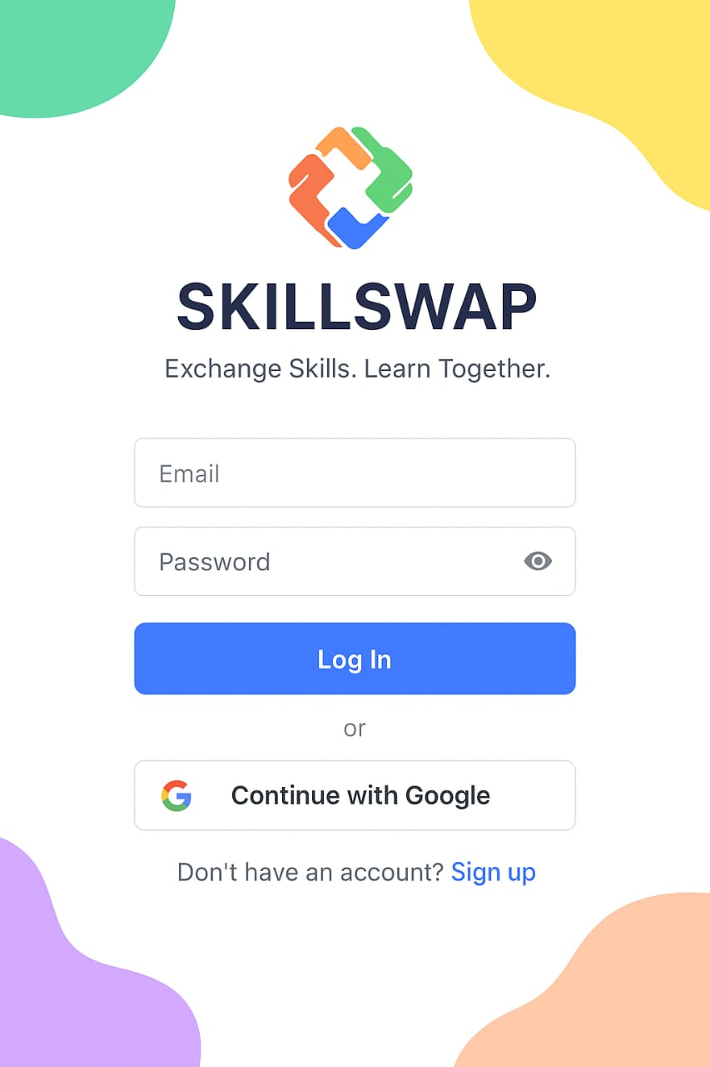
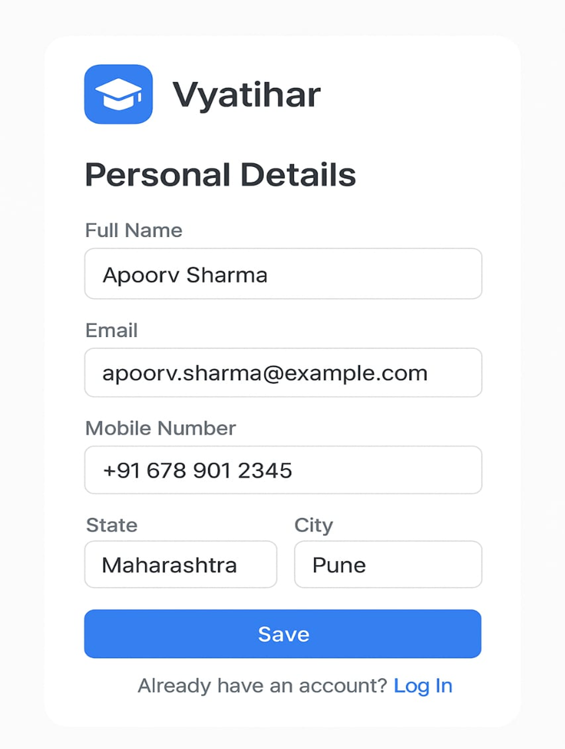







Slide 13


THANK YOU

